Slide 1

Rental Houses In Hyderabad

Slide 2


About us.
Name- Susmith Preetham
Background- Btech (Mechanical)
Name- Jawahar Surya
Background- Btech (Mechanical)

Slide 3
Business Problem.
To find average price of renting a house in different locations of Hyderabad.
Availability of houses based on House Facing.
What is the average price for different House Types.
Sorting locations based on Zone.
Zonal wise price analysis for House Type and Furniture.
Zonal wise House Availability based on House Facing.

Slide 4
Objective of the Project.
To provide assistance to find a House for rent in Hyderabad.
The main Objective of the Project is to provide House based on client requirement.

Slide 5
What is web scrapping ?
Web scraping is the process of extracting data from a website using a program or script. It involves navigating through the HTML code of a website and identifying the information that needs to be extracted, and then extracting that data and storing it in a structured format.
Steps in Web scrapping
-> Select the website to scrape.
-> Collect URL of pages to extract the data.
-> Using requests get the page data
-> Use Beautiful Soup to extract data from HTML
-> Extracted data is converted into CSV file

Slide 6
Libraries Used
Data Collection:
Requests
BeautifulSoup
Data Cleaning and Analysis
Python
Pandas
Regex
Data Visualization
Matplotlib
Seaborn
Plotly

Slide 7
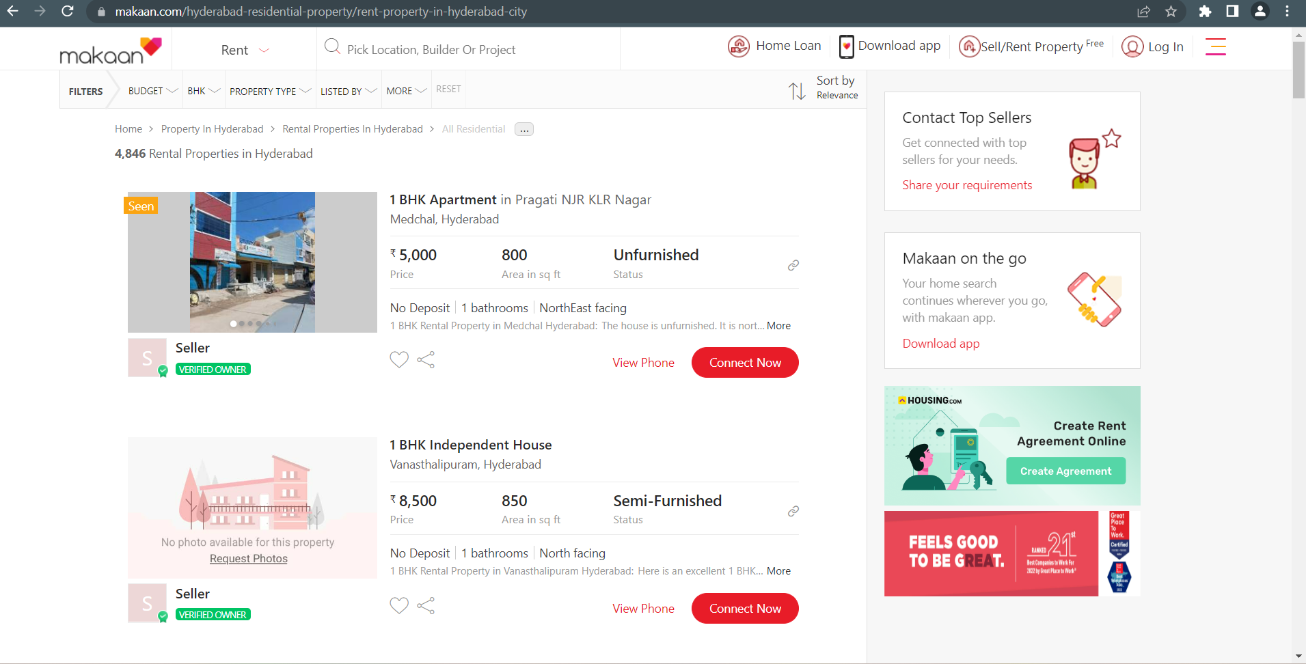
Website used for Scrapping.
We Used Makaan for
scrapping data.
Makaan is online website
which provides assistance
to buy or rent Houses in
any location in India.

Slide 8
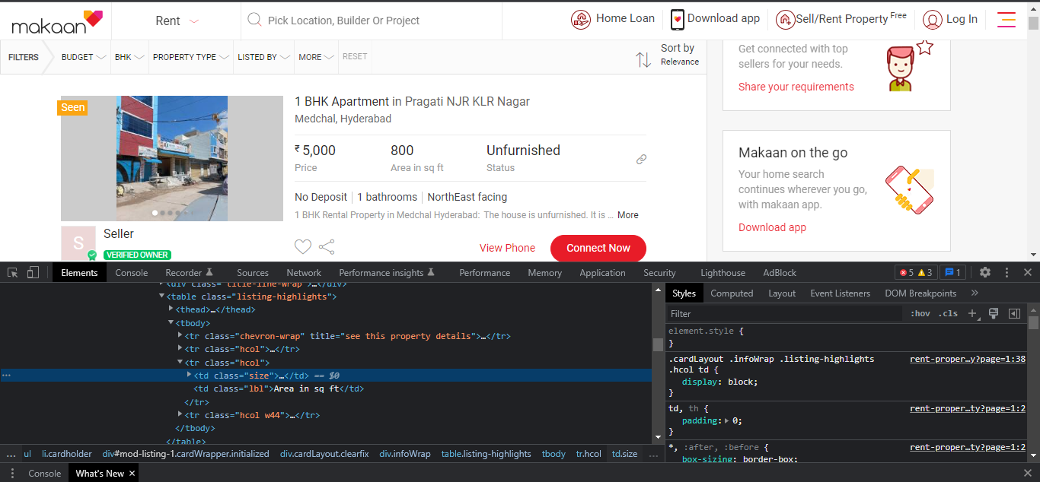
Data Collection from Website
First we selected the website URL and based on html class we divided the Data.
Using BueatifulSoup we collected the text inside the class.

Slide 9
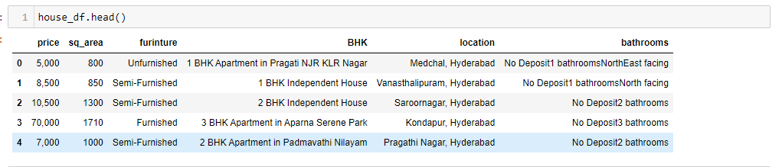
Data Collection from Website
The collected data is stored in dictionary and then written to CSV file.
The data in CSV file is raw and need to be cleaned in further process.

Slide 10
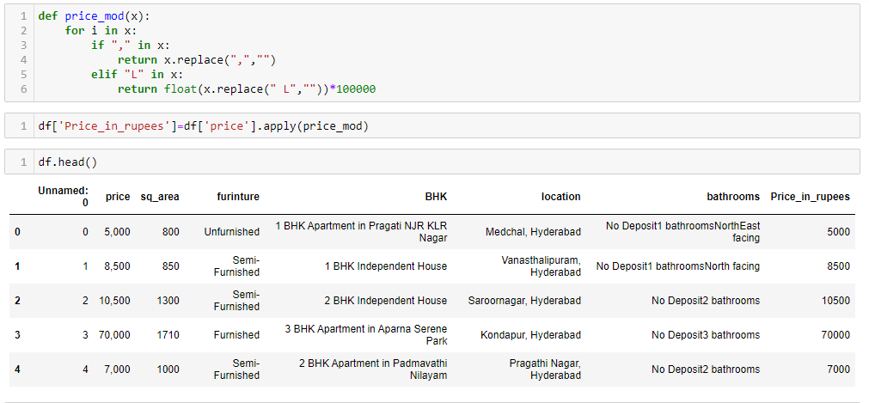
Data Cleaning Process
We cleaned data column wise and changed it data type accordingly
Removing "," and 'L' from price column using apply function and changing its data type to int

Slide 11
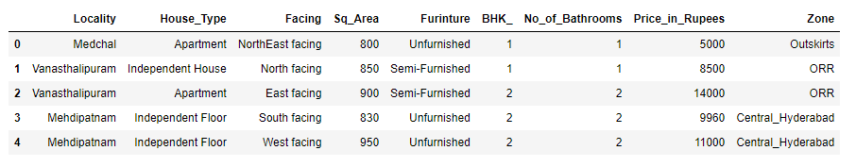
Data Cleaning Process
Separating digits and House Type from BHK column using apply and Regex.
Separating sublocation from location column and city.
And separating No of Bathrooms and Facing using regex.

Slide 12
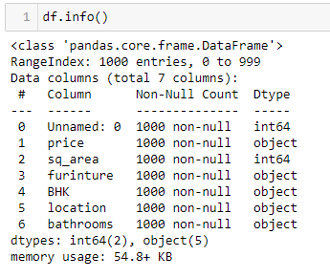
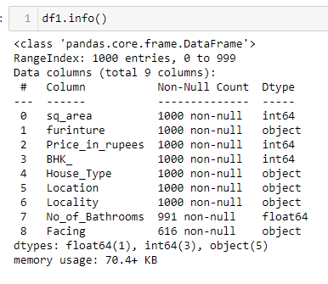
Converting Data Types and dropping Duplicates.
Data Types of objects is converted according to problem requirement.
And then duplicate values are removed
Before Cleaning
After Cleaning

Slide 13
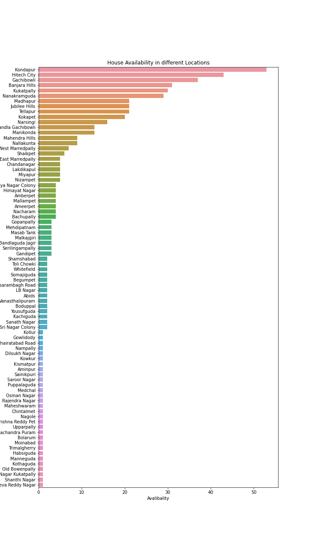
Data Analysis and Visualization
First we did analysis on every column and the result is shown in the form of Plots.

Slide 14
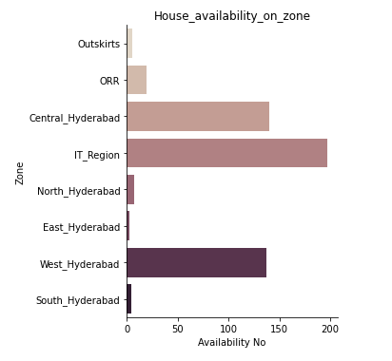
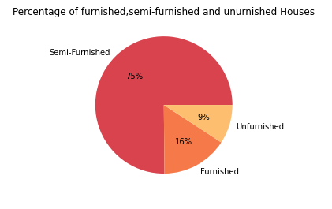
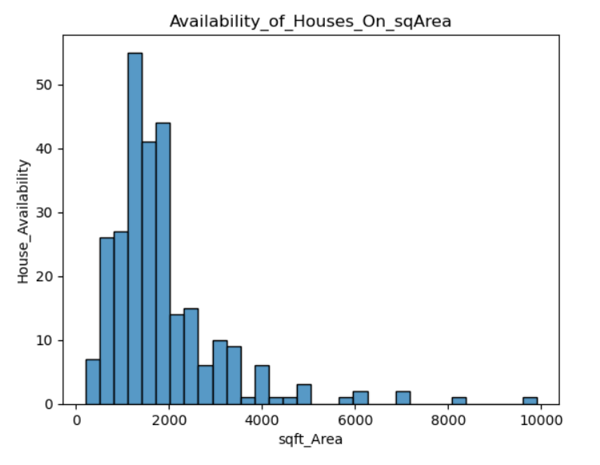
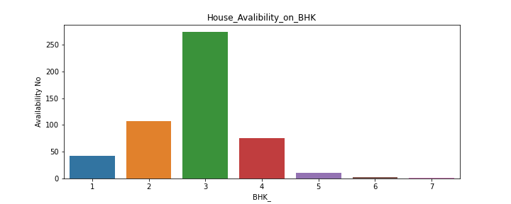
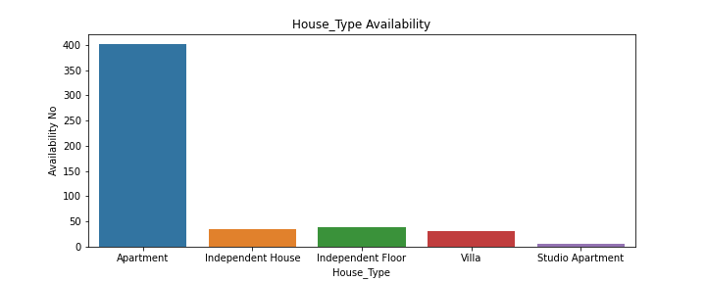
Univariate Analysis

Slide 15
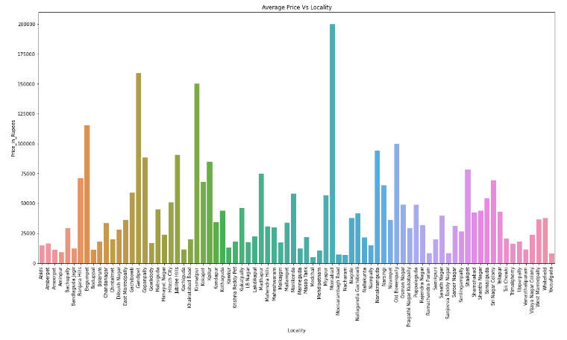
Analysis on Locality, House Type, Facing, Furniture Type, Zone, Sqft Area and BHK with Price
From the above bar plot we can observe that Moinabad has highest price.

Slide 16
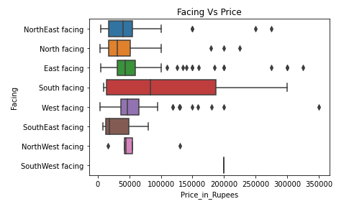
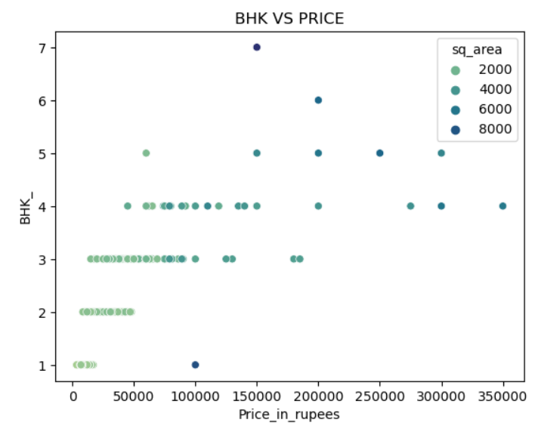
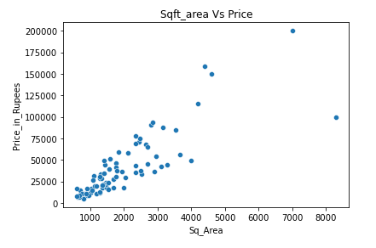
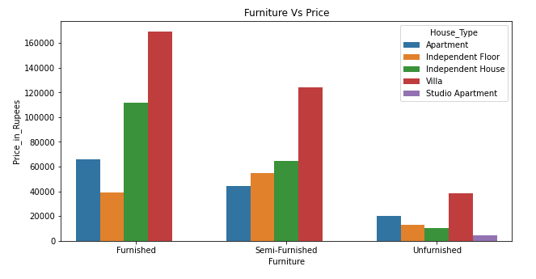
South Facing has wide price range.
3 BHK can be available below 1 lakh
Furnished Houses have more price compared to others.
More density is present in between 1000 and 3000

Slide 17
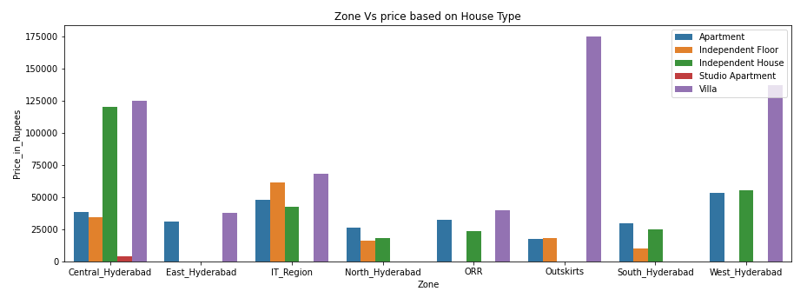
Analysis Based on Zone
It is difficult to analyse based on Locality so we divided them into zones.
Analysis on Zone and Price based on House Type
Villa have Highest Price in every zone.
In IT region all house types are almost equal price.

Slide 18
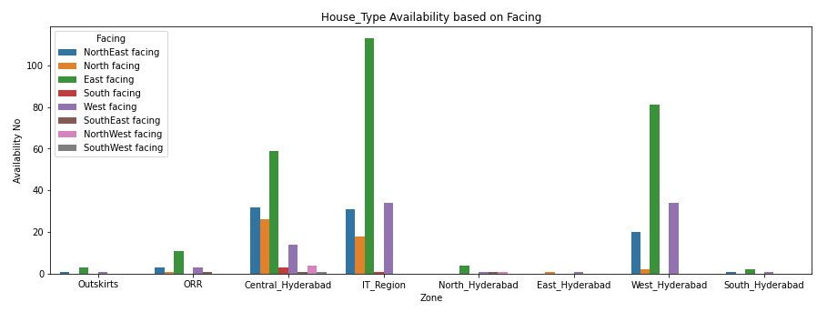
Analysis on Zone and Facing
From above graph it can be seen that IT region have more availability of houses in almost every facing when compared to other zones.

Slide 19
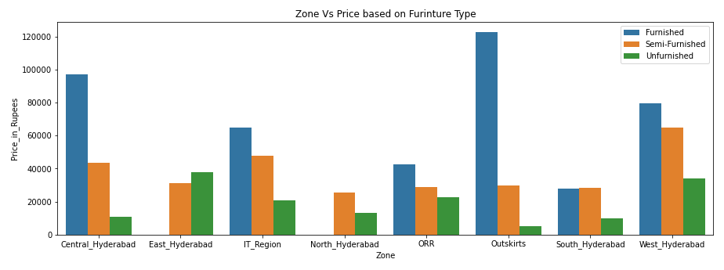
Analysis on Zone and Furniture Type
We can see that in almost every zone Furnished Houses are more and Unfurnished houses are less.

Slide 20
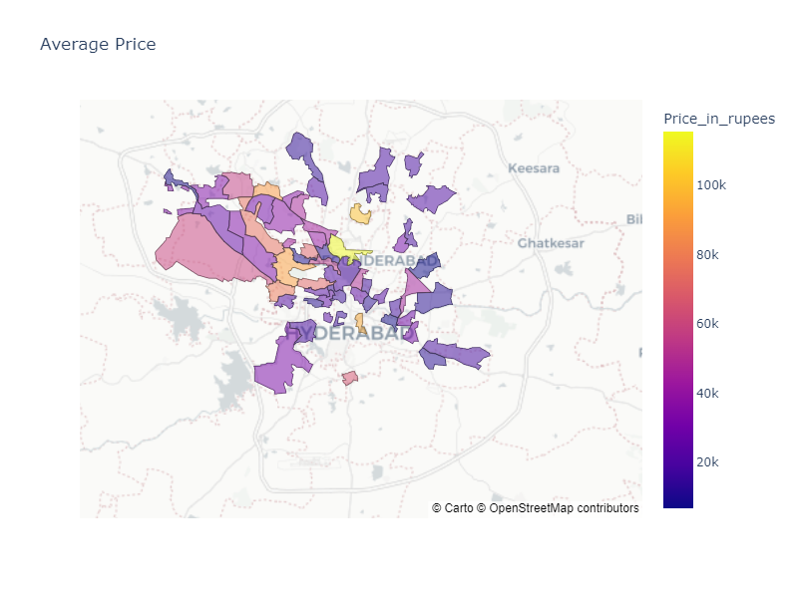
Choropleth Map of Hyderabad
Choropleth Map is used to represent data on actual Map based on Location.
It uses latitude and longitude data.
With help of json file we were able to plot this map.
file:///C:/Users/susmi/Desktop/Python/Project%201-Web%20scraping/hyderabad_map.html.

Slide 21
Conclusion.
Most of the areas that are present inside the IT sector Regions have high availability of rental houses.
The availability of Apartment Type rental houses are more compared to other House type.
The probability of getting a East Facing House Is more compared to other .
Most of the available houses are Semi-Furnished and 3 BHK.
The minimum price in our data is in Amberpet for 1 BHK.
The maximum price in our data is in Shaikpet for 5 BHK.

Slide 22
Problems Faced
During web scrapping for particular data.
Removing empty list values from the collected data.
Adding data manually for distribution of zones.
During plotting choropleth map .

Slide 23

THANK YOU

